Slide 1
PP Mini-Project
Title of Project
FY COMPS Sem II ( 2022-23)
Batch C2-1
Arya Madhani - 16010122099
Aakriti Mehta -16010122109
Harsh Nagrani - 16010122122

Slide 2
Problem Statement
To design an File Organizer using Python with OS module and tkinter that is able to scan a specified directory and helps the user arrange all his/her files (of type png,text,video, pdfs) in a sorted manner. This will help in cleaning up cluttered directories by grouping similar files together.

Slide 3
System Architecture
In the beginning, we imported the os, shutil, and Tkinter modules.
User Interface: You can create a simple command-line interface or a graphical user interface (GUI) using libraries like tkinter to interact with the user. The interface allows the user to input the directory they want to organize.
Input Validation: Validate the user input to ensure that the specified directory exists and is accessible.
File Sorting: Traverse through all the files in the given directory and classify them based on their file extensions. The os module is used to access and manipulate file paths and extensions.

Slide 4
Folder Creation: Create separate folders for each file type (e.g., "Text", "Images", "Documents", etc.) if they don't already exist within the given directory. The os module is used to create directories.
File Movement: Move each file to its respective folder based on its extension. Again, the os module is used to move files from one directory to another.
Testing: Perform testing on various scenarios, such as organizing files in different directories with different file types, to ensure the program functions as expected.

Slide 5
Features of designed System
Instead of doing it manually this Programs helps us to sort all the all the files having extensions ‘.png’ and ‘.txt’ , thus saving lot of time.

Slide 6
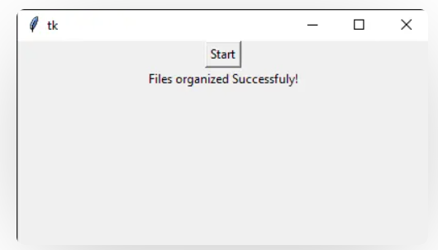
Result
The below GUI shows the output message after the successful organization of the files.

Slide 7
Conclusion
To ensure the successful outcome of this python code to create a Junk File Organizer In Python With OS Module, keep the following points in mind.
Choose the folder in which you need to organize files and make a subfolder with the same extension files.
The process is not easily reversible so do it cautiously.

Slide 8
References
https://geeksforgeeks.org
https://www.javapoint.om/python-tkinter

